Slide 1

Da Vinci PCT STU 2
Diagrams

Slide 2
Da Vinci (PCT) – GFE Coordination Workflow
Pre-Step: A patient schedules a service or requests an estimate for a service which triggers the collection of one or more GFEs. Note: This workflow is used when there is need for a standard means of coordinating on a GFE with multiple providers.
GFE Coordination Requester searches/retrieves identifiers of participating providers (GFE Contributors) from the Coordination Platform (CP).
Requester creates Coordination Task and Contributor Tasks that contain the information necessary to create an estimate.
Providers are notified of the new task and request.
Provider retrieves task and updates it to accept or reject.
Notifications of task updates are sent to the requester, including a change to a reject status and potentially a reason why.
When notified of a reject status, the requester can create a new contributor task for a different provider. Alternatively, the requester can cancel the entire request, and if appropriate, create a new request (with new task resources).
Contributing provider updates the task with a GFE Bundle and updates the status.
Requester can retrieve the full GFE Packet from the CP at any time. They may choose to close the request. Optional to have the CP deliver the GFE Packet.
Requester can update the Coordination Task when the GFE collection has concluded and no more changes, updates, or GFE Bundles will be accepted.
GFE Coordination Requester
Coordination Platform
GFE Contributor
1
Identifies Co-providers
Submits Request for Estimate via Task resources
2
Send Notification of Task
3
Retrieve and update Task
Accept/Decline participation in GFE collection
4
5
Notification of Task updates
6
Replace Co-providers
Submits GFE(s) and update Contributor Task
7
8
Retrieve GFE Packet
Update Coordination Task as completed
9

Slide 3
GFE Coordination Requester
Coordination Platform
GFE Contributor
1
Identifies Co-providers
Submits Request for Estimate via Task resources
2
Send Notification of Task
3
Retrieve and update Task
Accept/Decline participation in GFE collection
4
5
Notification of Task updates
6
Replace Co-providers
Submits GFE(s) and update Contributor Task
7
8
Retrieve GFE Packet
Update Coordination Task as completed
9

Slide 4
GFE Coordination Request Structure
GFE Coordination Bundle
(type = transaction)
Submitting as a bundle is recommended, but not required.
All Organization and Practitioner Resources pointed to by Tasks reside on the Coordinating Platform.
Provider Specific GFE Request Information Bundles (information and context about what is being requested) can be contained in the Task.input (preferred) or references a Bundle that is stored on the Coordination Platform (or being written to through the Request Bundle).
Requester (Practitioner/Organization)
GFE Coordinating Task
GFE Request Information Bundle
General
GFE Contributor Task
GFE Contributor Task
GFE Contributor Task
GFE Request Information Bundle
Provider Specific
GFE Request Information Bundle
Provider Specific
GFE Request Information Bundle
Provider Specific
GFE Contributor
(Practitioner/ PractitionerRole/Organization)
GFE Contributor
(Practitioner/ PractitionerRole/Organization)
GFE Contributor
(Practitioner/ PractitionerRole/Organization)

Slide 5
GFE Coordination Request Structure
GFE Coordination Bundle
(type = transaction)
Coordination Platform
Submitting as a bundle is recommended, but not required.
All Organization and Practitioner Resources pointed to by Tasks reside on the Coordinating Platform.
Provider Specific GFE Request Information Bundles (information and context about what is being requested) can be contained in the Task.input (preferred) or references a Bundle that is stored on the Coordination Platform (or being written to through the Request Bundle).
GFE Coordination Task
Requester (Practitioner /Organization)
GFE Information Bundle
General
GFE Contributor Task
GFE Contributor Task
GFE Contributor Task
GFE Contributor
(Practitioner/ PractitionerRole/Organization)
GFE Information Bundle
Provider Specific
GFE Information Bundle
Provider Specific
GFE Information Bundle
Provider Specific
GFE Contributor
(Practitioner/ PractitionerRole/Organization)
GFE Contributor
(Practitioner/ PractitionerRole/Organization)

Slide 6
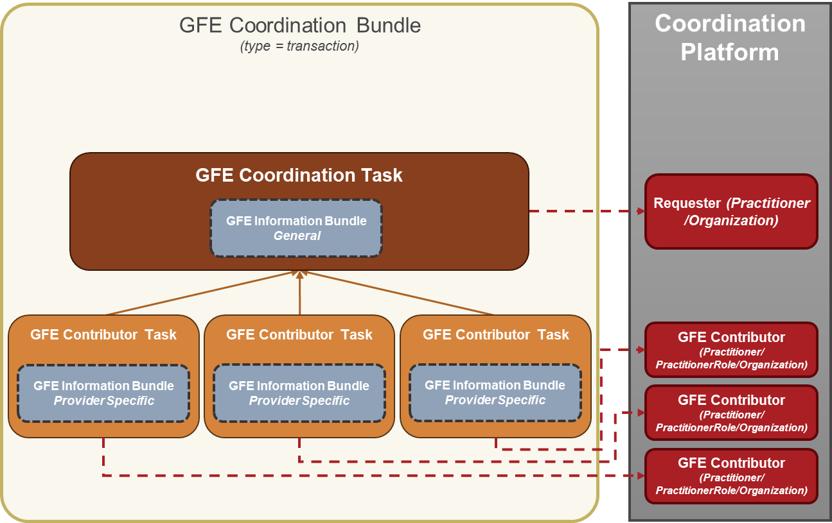

Slide 7
GFE Coordination Request Structure
On Coordination Platform
Submitting as a bundle is recommended, but not required.
All Organization and Practitioner Resources pointed to by Tasks reside on the Coordinating Platform.
Provider Specific GFE Request Information Bundles (information and context about what is being requested) can be contained in the Task.input (preferred) or references a Bundle that is stored on the Coordination Platform (or being written to through the Request Bundle).
Coordination Platform
GFE Coordination Task
Requester (Practitioner /Organization)
GFE Information Bundle
General
GFE Contributor Task
GFE Contributor Task
GFE Contributor Task
GFE Contributor
(Practitioner/ PractitionerRole/Organization)
GFE Information Bundle
Provider Specific
GFE Information Bundle
Provider Specific
GFE Information Bundle
Provider Specific
GFE Contributor
(Practitioner/ PractitionerRole/Organization)
GFE Contributor
(Practitioner/ PractitionerRole/Organization)

Slide 8
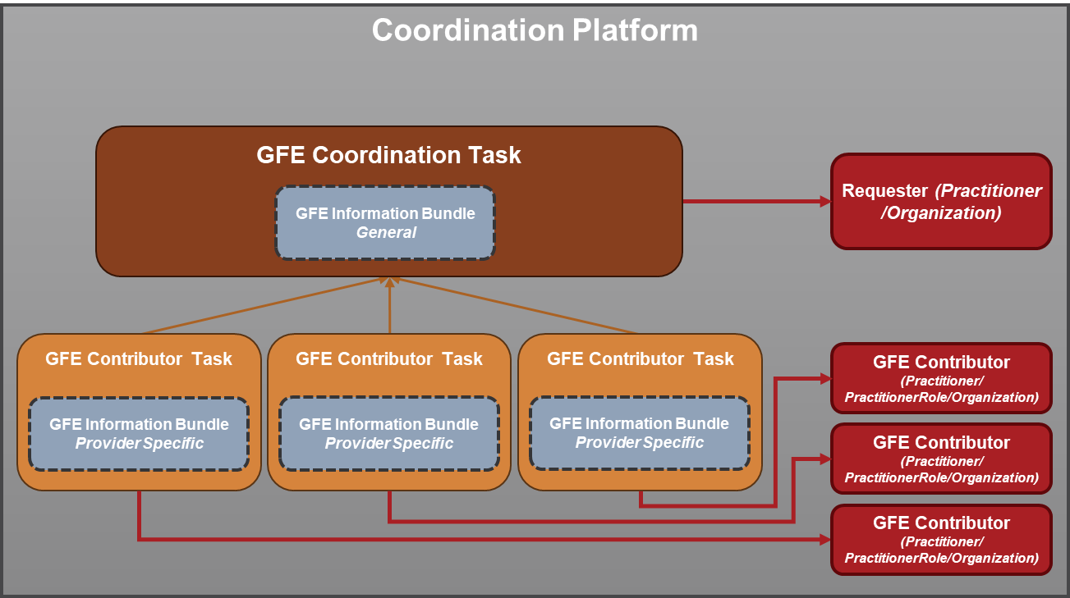

Slide 9
GFE Request Information Bundle
GFE Information Bundle
(type = collection)
Payer Organization is optional
Multiple Organization, Practitioner, or PractitionerRole resources can be indicated
Any combination of request items are allowed as long as there is at least 1 (Should that also be the case for the Provider Specific Task?
DocumentReference attachments are optional
US Core Patient
PCT Coverage
PCT Organization (Payer)
PCT Organization (requested)
PCT Practitioner
(requested)
HRex PractitionerRole
(requested)
(requested-items)
ServiceRequest
ServiceRequest
ServiceRequest
ServiceRequest
ServiceRequest
ServiceRequest
PCT ServiceRequest
PCT MedicationRequest
PCT DeviceRequest
ServiceRequest
ServiceRequest
ServiceRequest
ServiceRequest
NutritionOrder
VisionPrescription
DocumentReference
DocumentReference
DocumentReference

Slide 10
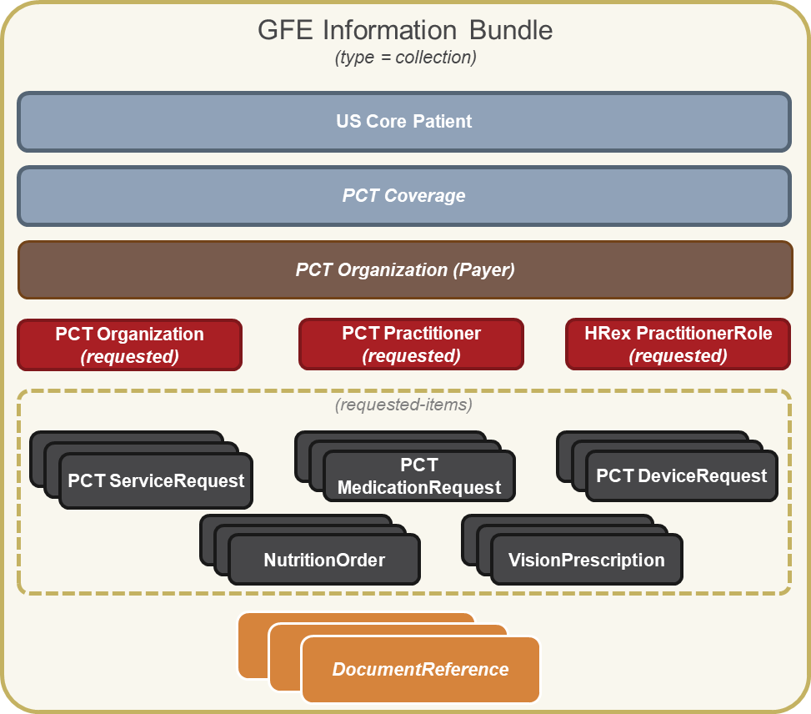

Slide 11
GFE Bundle Structure
GFE Bundle
US Core Patient
PCT Coverage
PCT Organization
(Payer)
GFE Missing Bundle
Good Faith Estimate (GFE) Summary
Totals
US Core Patient
PCT Practitioner
(Requested)
PCT Organization
(Requested)
or
Good Faith Estimate (GFE)
Estimated Date of Service
Diagnoses/Procedures
Line items
Product/Service
Quantity/Price
Total
Good Faith Estimate (GFE)
Estimated Date of Service
Diagnoses/Procedures
Line items
Product/Service
Quantity/Price
Total
PCT Organization (Provider)
(requested-items)
Good Faith Estimate (GFE) Institutional or Professional Claim Resource
Estimated Date of Service
Diagnoses/Procedures
Line items
Product/Service
Quantity/Price
Total
PCT Organization (Provider)
PCT Organization (Provider)
PCT ServiceRequest
PCT MedicationRequest
PCT DeviceRequest
PCT Practitioner
PCT Practitioner
PCT Practitioner
NutritionOrder
VisionPrescription

Slide 12
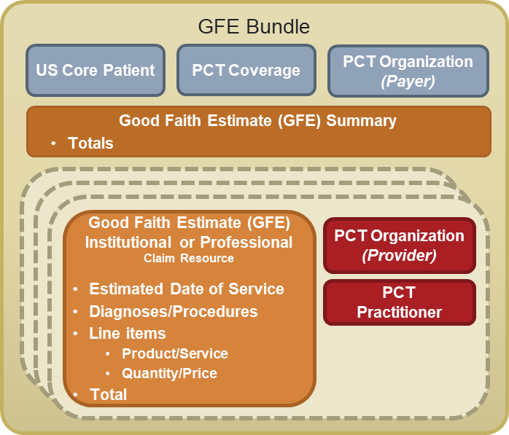
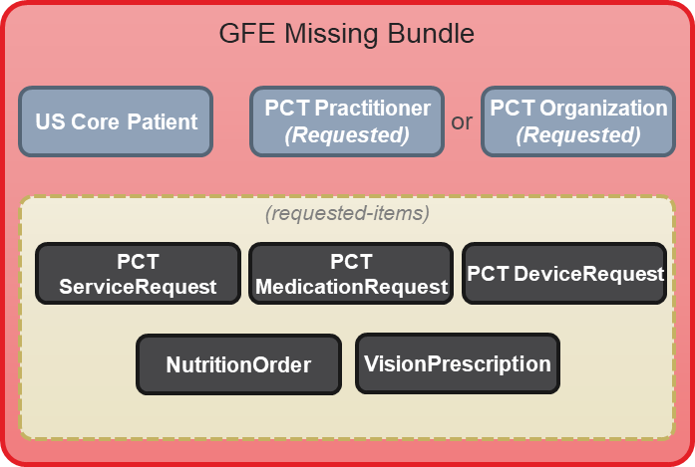

Slide 13

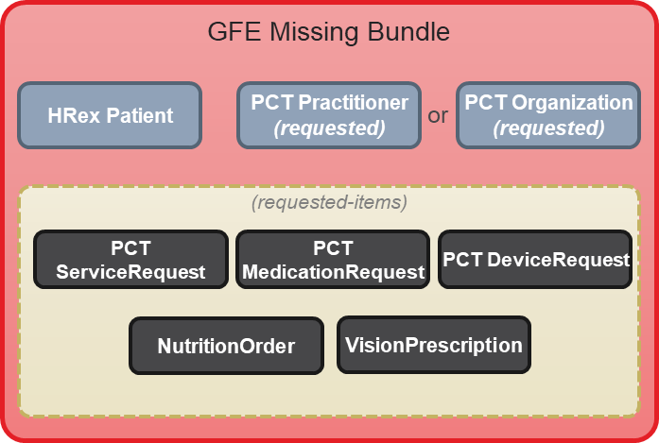
GFE Packet Structure
GFE Packet
GFE Composition
US Core Patient
PCT Practitioner/Organization
(requester/submitter)
PCT Coverage
PCT Organization
(Payer)

Slide 14
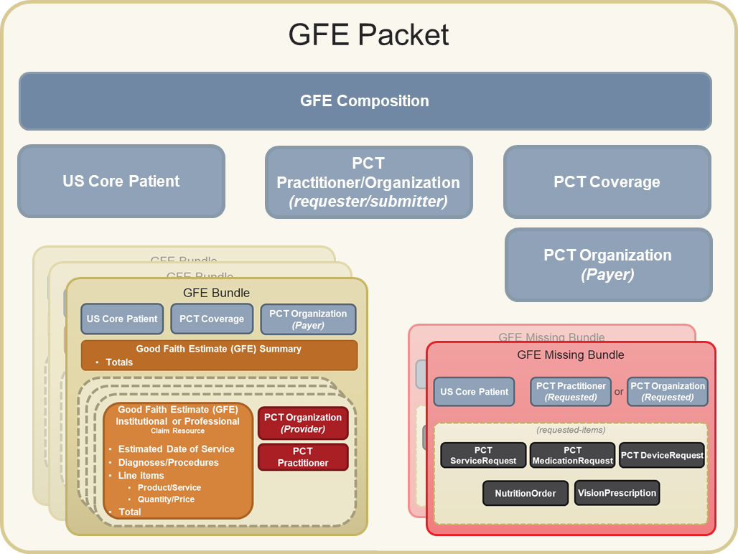

Slide 15
AEOB Packet Structure
AEOB Packet
AEOB Packet
AEOB Composition
AEOB Composition
US Core Patient
PCT Coverage
PCT Organization (Payer)
US Core Patient
PCT Coverage
PCT Organization (Payer)
Advanced Explanation of Benefit (AEOB) Summary
Totals/Benefits
Advanced Explanation of Benefit (AEOB) Summary
Totals/Benefits
Good Faith Estimate (GFE)
Estimated Date of Service
Diagnoses/Procedures
Line items
Product/Service
Quantity/Price
Total
Good Faith Estimate (GFE)
Estimated Date of Service
Diagnoses/Procedures
Line items
Product/Service
Quantity/Price
Total
Good Faith Estimate (GFE)
Estimated Date of Service
Diagnoses/Procedures
Line items
Product/Service
Quantity/Price
Total
PCT Organization (Provider)
Good Faith Estimate (GFE)
Estimated Date of Service
Diagnoses/Procedures
Line items
Product/Service
Quantity/Price
Total
PCT Organization (Provider)
Advanced Explanation of Benefit (AEOB) ExplanationOfBenefit Resource
GFE reference
Line items
Product/Service
Adjudication amounts
Medical Mgmt Reqs.
Totals
PCT Organization (Provider)
Advanced Explanation of Benefit (AEOB) ExplanationOfBenefit Resource
GFE reference
Line items
Product/Service
Adjudication amounts
Medical Mgmt Reqs.
Totals
PCT Organization (Provider)
PCT Organization (Provider)
PCT Organization (Provider)
PCT Practitioner
PCT Practitioner
PCT Practitioner
PCT Practitioner
PCT Practitioner
PCT Practitioner

Slide 16
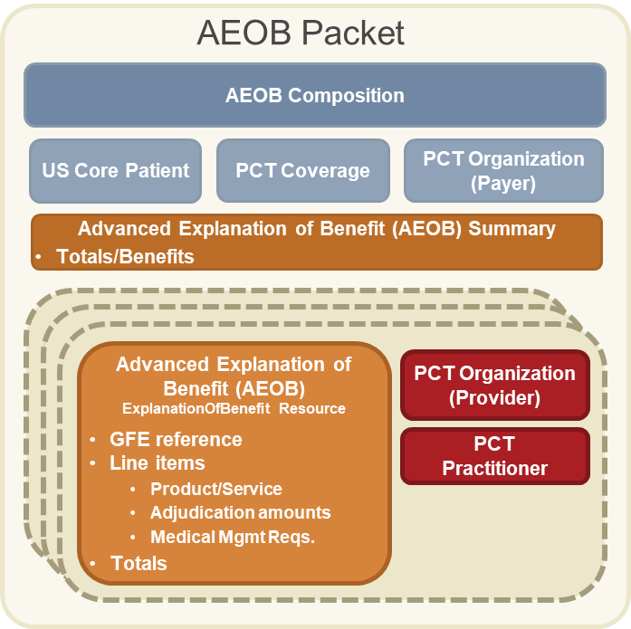
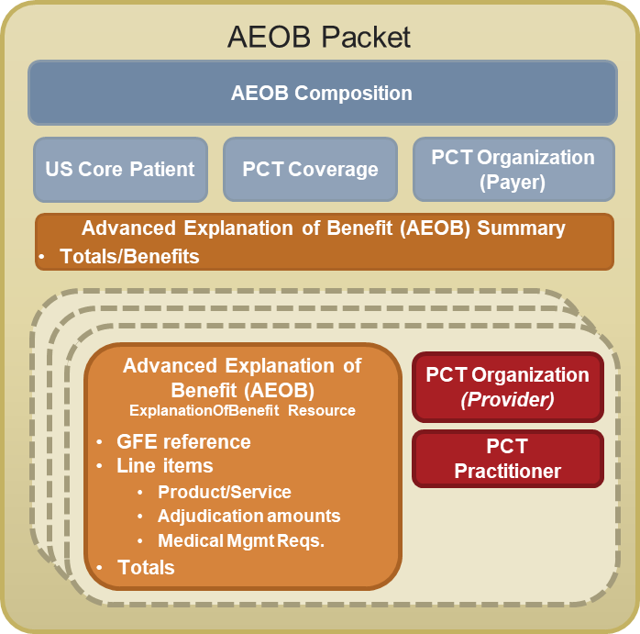
AEOB Packet Structure

